Slide 1
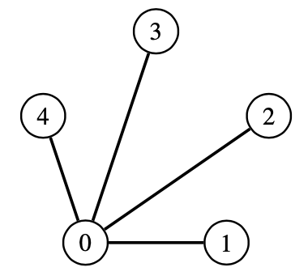
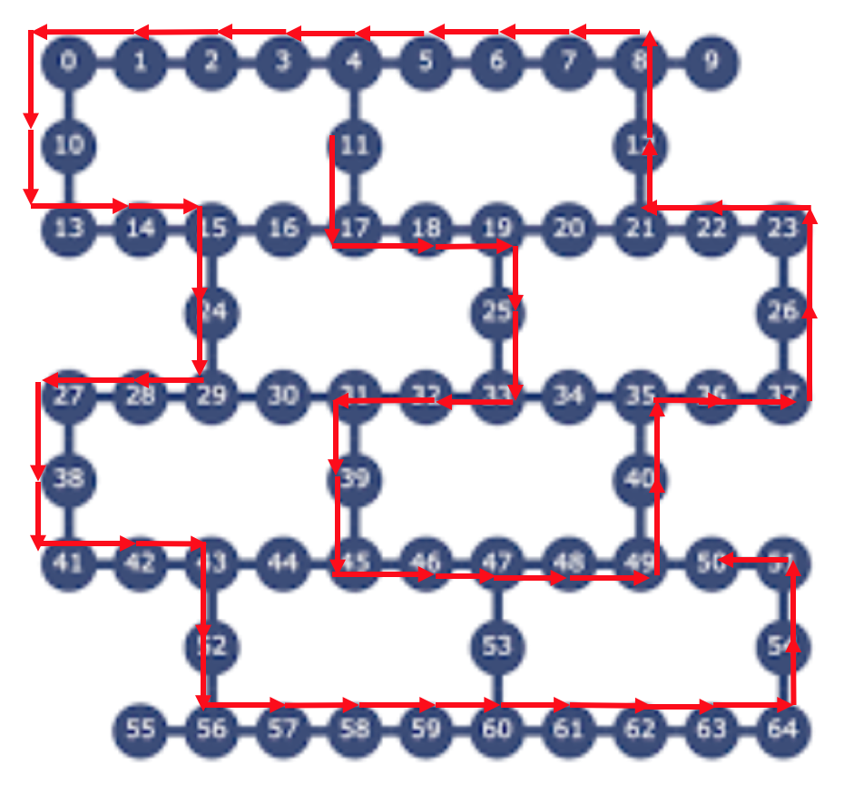
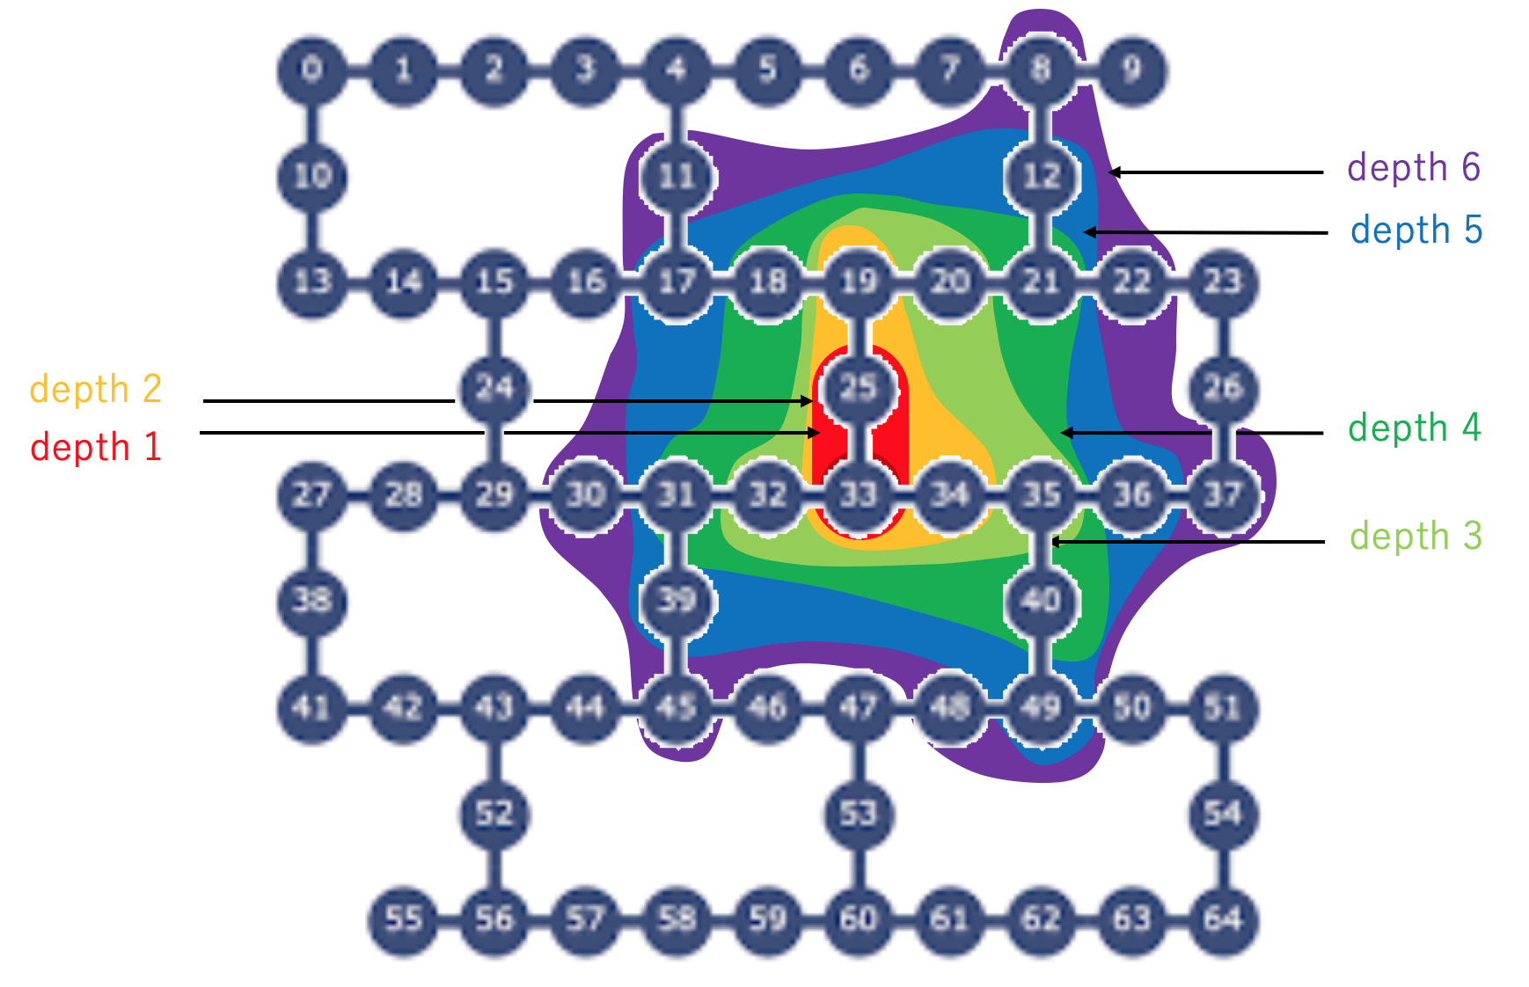
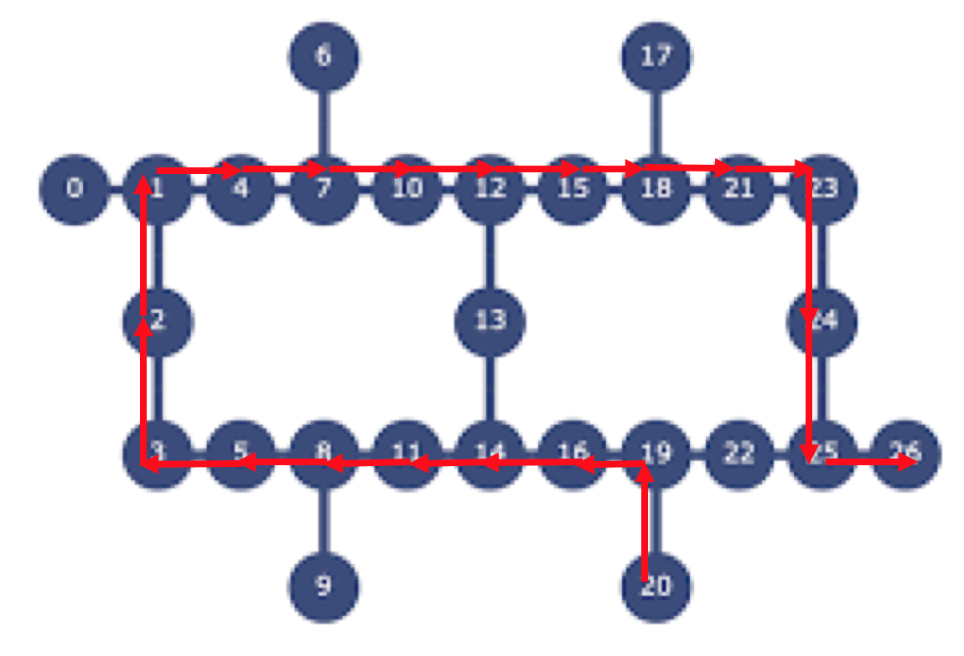
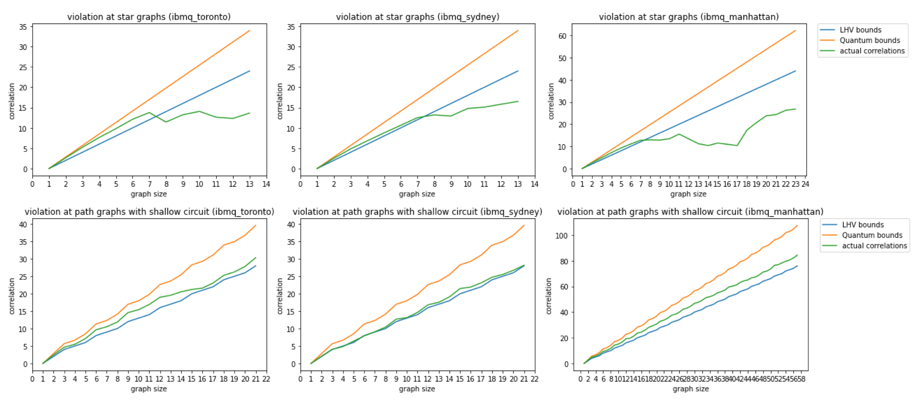
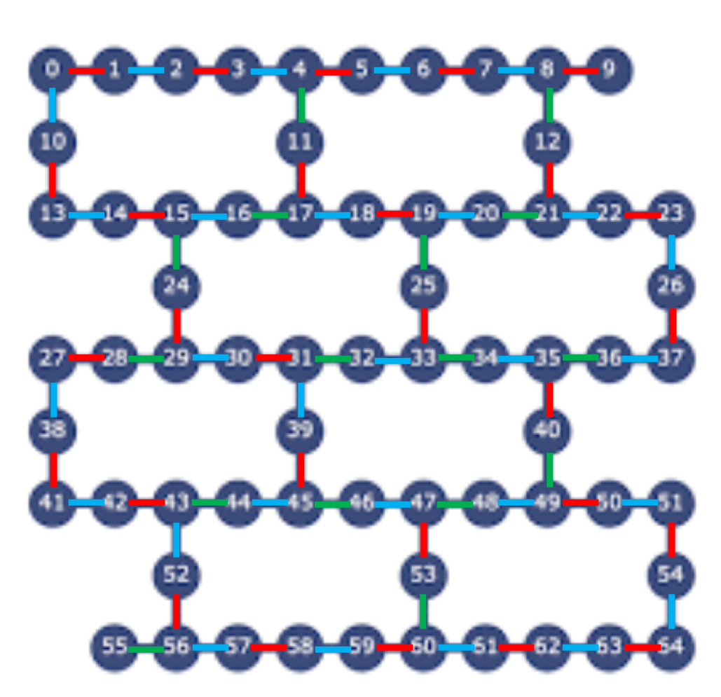
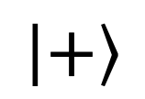
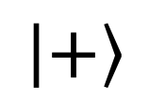
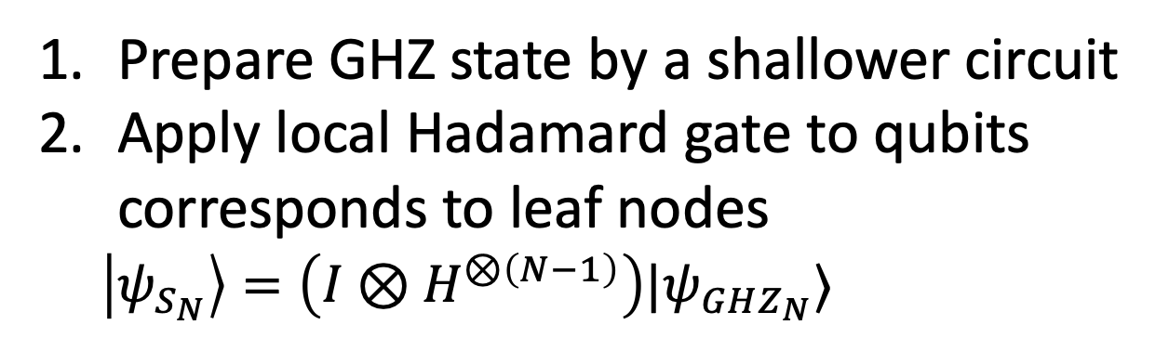
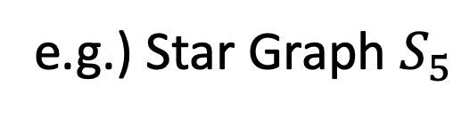
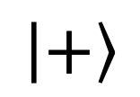
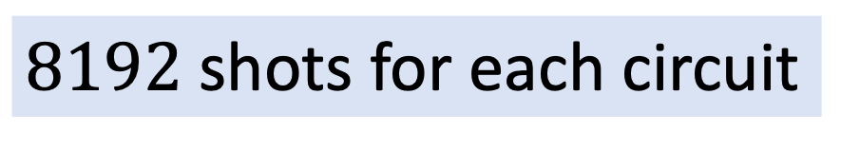
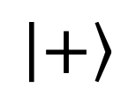
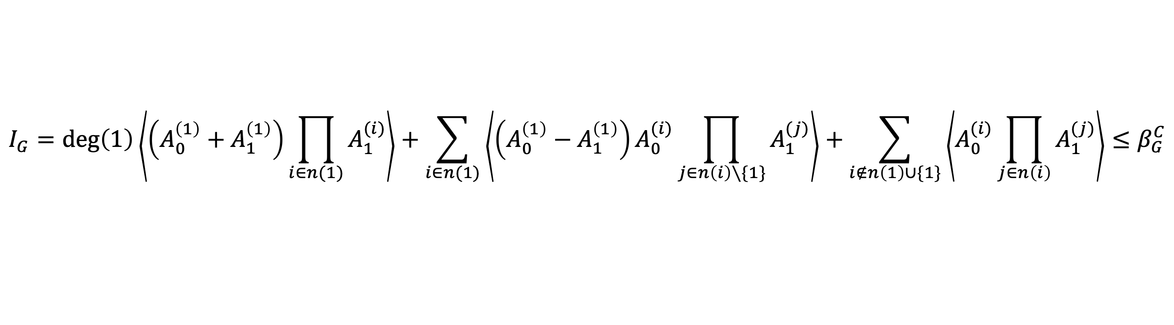
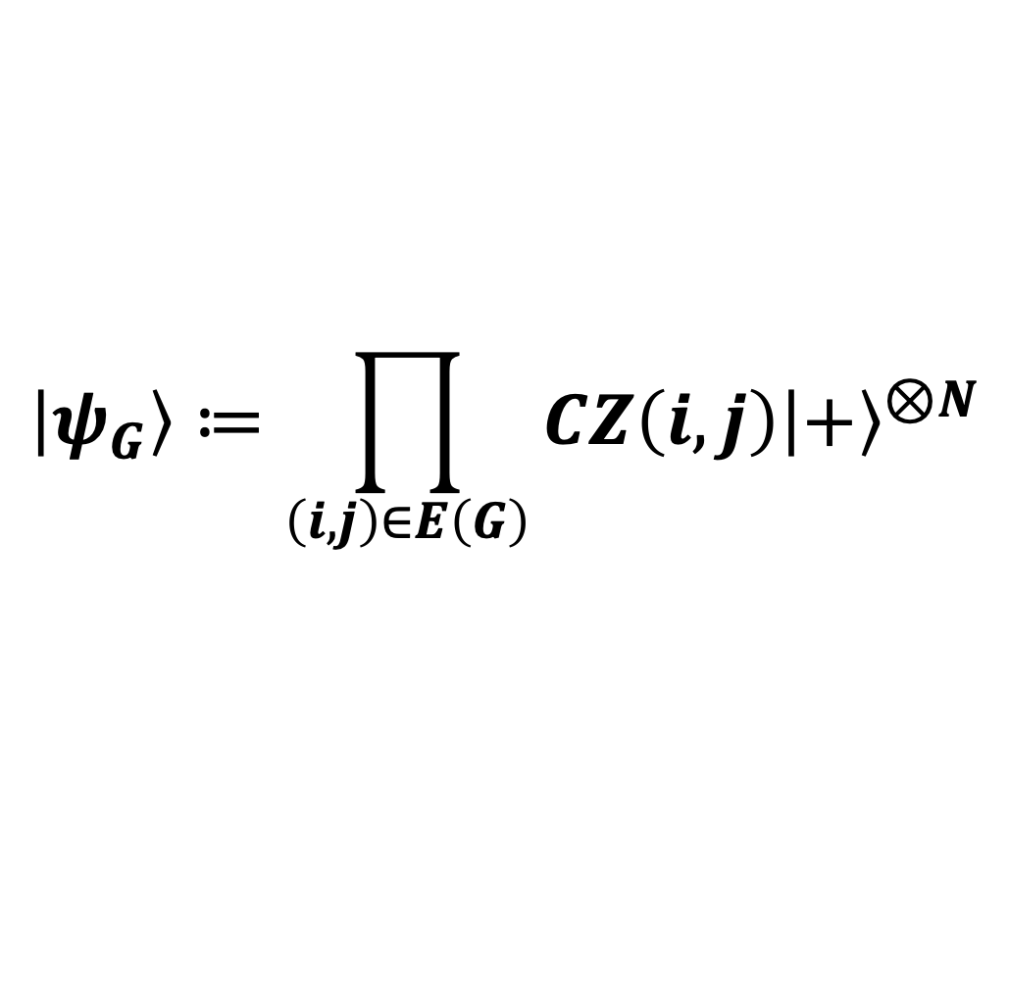
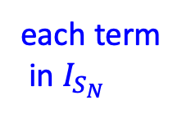
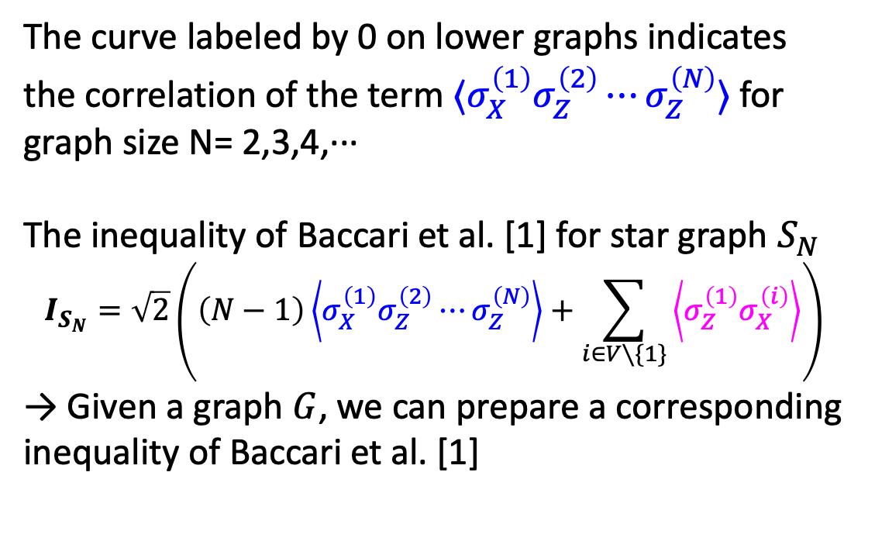
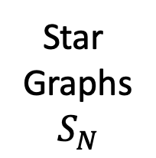
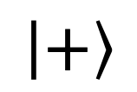
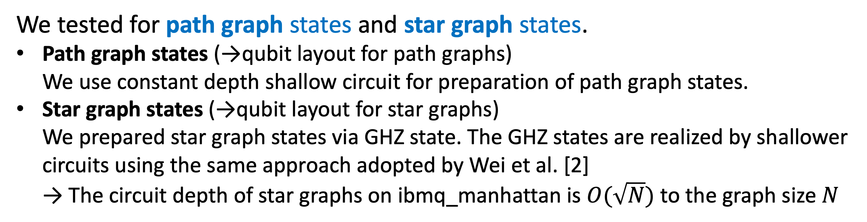
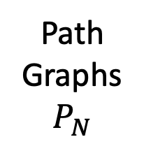
Testing Scalable Bell Inequalities for Quantum Graph States
on IBM Quantum Devices
Bo Yang¹, Rudy Raymond², Hiroshi Imai¹, Hyungseok Chang¹, and Hidefumi Hiraishi¹
1: Graduate School of Information Science and Technology, The University of Tokyo 2: IBM Quantum, IBM Research Tokyo
Motivation
Noisy quantum devices with dozens of qubits (~100 qubits) are available from IBM Quantum Experience (e.g. 65-qubit device of ibmq_manhattan).
Preparing and verifying entangled multi-qubit states is important:
for benchmarking the large quantum devices.
for the evaluation of the large quantum states.
We focus on graph state
$$\left|+\right\rangle$$
$$\left|ψ_{G}\right\rangle ≔\prod_{\left(i,j\right)∈E\left(G\right)}{CZ\left(i,j\right){\left|+\right\rangle }^{⊗N}}$$
$$\left|+\right\rangle$$
CZ
$$\left|+\right\rangle$$
Graph state has wide applications
the resource for measurement-based quantum computing
quantum error correction codes
CZ
CZ
Experimental verification of multi-qubit quantum states
$$\left|+\right\rangle$$
CZ
$$\left|+\right\rangle$$
e.g.) Star Graph $S_{5}$
Many approaches for the verification: e.g.
Bell inequality can be used for entanglement verification of quantum state
Bell inequality for graph state was firstly proposed by Gühne et al. [5] (2005)
Wei et al. [2] (2019)
Verification of 18-qubit GHZ state on the IBM Quantum 20-qubit device by a scalable entanglement metric based on multiple quantum coherences.
Huang et al. [3] (2020)
Using Mermin-type Bell inequality to confirm good entanglement of GHZ states on IBM Quantum up to size 5.
A Scalable Bell inequality for graph state was proposed by Baccari et al. [1] (2018) → The number of terms scales linearly to graph size
$$I_{G}=\deg\left(1\right)\left\langle \left(A_{0}^{\left(1\right)}+A_{1}^{\left(1\right)}\right)\prod_{i∈n(1)}{A_{1}^{(i)}}\right\rangle +\sum_{i∈n(1)}{\left\langle \left(A_{0}^{\left(1\right)}−A_{1}^{\left(1\right)}\right)A_{0}^{(i)}\prod_{j∈n\left(i\right)∖\{1\}}{A_{1}^{(j)}}\right\rangle }+\sum_{i∉n\left(1\right)∪\{1\}}{\left\langle A_{0}^{(i)}\prod_{j∈n\left(i\right)}{A_{1}^{(j)}}\right\rangle }≤β_{G}^{C}$$
The gap between classical bound $β_{G}^{C}$and quantum bound $β_{G}^{Q}$ is clear: $β_{G}^{Q}/β_{G}^{C}≤\sqrt{2}$
We used modified type of this inequality which is also mentioned in [1]
Aim of Our Experiments
On IBM Quantum devices, how big the graph states can violate the Bell inequality by Baccari et al. [1]?
Preparing Graph States
Qubit layout for path graphs
Qubit layout for star graphs
We used following IBM Quantum Devices (QV32)
65-qubit device (ibmq_manhattan)
27-qubit devices (ibmq_toronto, ibmq_sydney)
Both graph states can be realized without qubit swapping on the qubit topology of IBM Quantum devices.
Prepare GHZ state by a shallower circuit
Apply local Hadamard gate to qubits corresponds to leaf nodes
$\left|ψ_{S_{N}}\right\rangle =\left(I⊗H^{⊗\left(N−1\right)}\right)|ψ_{GHZ_{N}}⟩$
We tested for path graph states and star graph states.
Path graph states (→qubit layout for path graphs) We use constant depth shallow circuit for preparation of path graph states.
Star graph states (→qubit layout for star graphs) We prepared star graph states via GHZ state. The GHZ states are realized by shallower circuits using the same approach adopted by Wei et al. [2] → The circuit depth of star graphs on ibmq_manhattan is $O(\sqrt{N})$ to the graph size $N$
ibmq_manhattan
 | ibmq_toronto, ibmq_sydney | ibmq_manhattan
the size of path graphs used for experiments | 2 ~ 21 | 2 ~ 57
the size of star graphs used for experiments | 2 ~ 27 | 2 ~ 39
ibmq_toronto
ibmq_sydney
On ibmq_manhattan
Experimental Results
$8192$ shots for each circuit
Our Contribution
We support the benefits of the scalability of Bell inequality proposed by Baccari et al. [1] by our experimental results.
The correlation of path graphs and star graphs on IBM Quantum devices
Path
Graphs
$$P_{N}$$
ibmq_toronto
ibmq_sydney
ibmq_manhattan
Device(ibmq_) | Path Graph | Star Graph
Toronto | 21 | 6 (11)
Sydney | 21 | 7 (10)
Manhattan | 57 | 7 (7)
↑
stable and
clear violation
↑
stable and
clear violation
Table of maximum size of violation we report in different graphs on each devices
↑
stable violation
with tensored error mitigation
Star
Graphs
$$S_{N}$$
Efficient tensored mitigation inspired by Mooney et al. [8]
After every application of calibration matrix, probability values that are below certain shot scales are ignored.
Negative probability values are summed up and finally distributed to whole positive probability values.
Future Works
each term
in $I_{S_{N}}$
Negative
Correlation
Negative
Correlation
Negative
Correlation
The correlation of the first term for star graphs gets into negative area for some graph sizes (e.g. size 10, 11 on ibmq_manhattan)
Likely to be caused by dephasing error of T1/T2 relaxation when making GHZ state (mentioned in [2])
We also report the violation of inequality of Baccariet al. in the subdivied honeycomb graph using whole 65-qubits, which is the qubit topology of ibmq_manhattan.
classical bound : 88
quantum bound : 121.966
our result : 90.298
The curve labeled by 0 on lower graphs indicates the correlation of the term $⟨σ_{X}^{\left(1\right)}σ_{Z}^{\left(2\right)}⋯σ_{Z}^{\left(N\right)}⟩$ for graph size N= 2,3,4,···
The inequality of Baccari et al. [1] for star graph $S_{N}$
$$I_{S_{N}}=\sqrt{2}\left(\left(N−1\right)\left\langle σ_{X}^{\left(1\right)}σ_{Z}^{\left(2\right)}⋯σ_{Z}^{\left(N\right)}\right\rangle +\sum_{i∈V∖\{1\}}{\left\langle σ_{Z}^{\left(1\right)}σ_{X}^{\left(i\right)}\right\rangle }\right)$$
→ Given a graph $G$, we can prepare a corresponding inequality of Baccari et al. [1]
The refocusing method used in [2] or the dynamical decoupling techniques used in the experiments by Pokharel et al. [7] might improve these negative correlations
Error mitigation based on continuous time Markov process model (CTMP) by Bravyi et al. [6] would also improve our results. → We would obtain better results than tensored mitigation by taking account of two qubit cross-talk
References
[1] F. Baccari, R. Augusiak, I.ˇSupi ́c, J. Tura, and A. Aćın, Scalable bell inequalities for qubit graph states and robust self-testing, Phys. Rev. Lett.124, 020402 (2020)
[2] K. X. Wei, I. Lauer, S. Srinivasan, N. Sundaresan, D. T. McClure, D. Toyli, D. C. McKay, J. M. Gambetta, and S. Sheldon, Verifying multipartite entangled greenberger-horne-zeilinger states via multiple quantum coherences, Phys. Rev. A101, 032343 (2020)
[3] W. Huang, W. Chien, C. Cho, C. Huang, T. Huang, and C. Chang, Mermin’s inequalities of multiple qubits with orthogonal measurements on ibm q 53-qubit system, Quantum Engineering2, 10.1002/que2.45 (2020).
[4] D. González, D. F. de la Pradilla, and G. González, Revisiting the experimental test of mermin’s inequalities at ibmq, International Journal of Theoretical Physics59,3756–3768 (2020).
[5] O. Gühne, G. Tóth, P. Hyllus, and H. J. Briegel, Bell inequalities for graph states, Physical Review Letters95,10.1103/physrevlett.95.120405 (2005).
[6] Bravyi, Sergey, et al. "Mitigating measurement errors in multi-qubit experiments." arXiv preprint arXiv:2006.14044 (2020).
[7] Pokharel, Bibek, et al. "Demonstration of fidelity improvement using dynamical decoupling with superconducting qubits." Physical review letters 121.22 (2018): 220502.
[8] Mooney, Gary J., et al. "Generation and verification of 27-qubit Greenberger-Horne-Zeilinger states in a superconducting quantum computer." arXiv preprint arXiv:2101.08946 (2021).

